Slide 1
GRAPH THEORY Lecture # 20

Slide 2
INTRODUCTION
Graph theory plays an important role in several areas of computer science such as:
Switching Theory and Logical Design
Artificial Intelligence
Formal Languages
Computer Graphics
Operating Systems
Compiler Writing
Information Organization and Retrieval.

Slide 3
GRAPH
A graph is a non-empty set of points called vertices and
A set of line segments joining pairs of vertices called edges.
Formally, a graph G consists of two finite sets:
A set V = V(G) of vertices (or points or nodes)
A set E = E(G) of edges;
where each edge corresponds to a pair of vertices.

Slide 4
EXAMPLE
We have five vertices labeled by v₁, v₂, v₃, v₄, v₅ .
We have edges e₁, e₂, e₃, e₄, e₅, e₆ .

Slide 5
e₁ edge is for vertices v₁ and v₂ .
e₂ and e₃ are end points v₁ and v₄.
e₄ has end points v₂ and v₄ .
e₅ has end points v₂ and v₃ .
e₆ is a loop .

Slide 6
SOME TERMINOLOGY
An edge connects either one or two vertices called its endpoints (edge e₁ connects vertices v₁ and v₂ described as {v₁, v₂} i.e v₁ and v₂ are the endpoints of an edge e₁).

Slide 7
An edge with just one endpoint is called a loop. Thus a loop is an edge that connects a vertex to itself (e.g., edge e₆ ).
Two vertices that are connected by an edge are called adjacent; and a vertex that is an endpoint of a loop is said to be adjacent to itself.
An edge is said to be incident on each of it endpoints(i.e. e₁ is incident on v₁ and v₂ ).

Slide 8
A vertex on which no edges are incident is called isolated (e.g., v₅)
Two distinct edges with the same set of end points are said to be parallel (i.e. e₂ & e₃).

Slide 9
EXAMPLE
Define the following graph formally by specifying its vertex set, its edge set, and a table giving the edge endpoint function.

Slide 10
SOLUTION
Vertex Set = {v₁, v₂, v₃, v₄}
Edge Set = {e₁, e₂, e₃}
Edge - endpoint function is:
Edge | Endpoint
e₁ | {v₁, v₂}
e₂ | {v₁, v₃}
e₃ | {v₃}

Slide 11
EXAMPLE
For the graph shown below:
Find all edges that are incident on v₁;
Find all vertices that are adjacent to v₃;
Find all loops;
Find all parallel edges;
Find all isolated vertices;

Slide 12
SOLUTION
Find all edges that are incident on v₁?
v₁ is incident with edges e₁, e₂ and e₇
Find all vertices that are adjacent to v₃?
vertices adjacent to v₃ are v₁ and v₂
Find all loops?
Loops are e₁ and e₃

Slide 13
Find all parallel edges?
Only edges e₄ and e₅ are parallel
Find all isolated vertices?
The only isolated vertex is v₄ in this Graph.

Slide 14
EXERCISE
Draw picture of Graph H having vertex set {v₁, v₂, v₃, v₄, v₅} and edge set {e₁, e₂, e₃, e₄} with edge endpoint function:
Edge | Endpoint
e₁ | {v₁}
e₂ | {v₂, v₃}
e₃ | {v₂, v₃}
e₄ | {v₁, v₅}

Slide 15
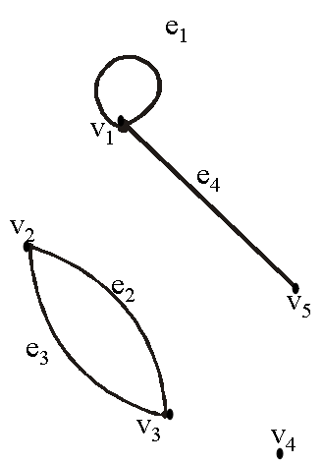
EXERCISE
Given V(H) = {v₁, v₂, v₃, v₄, v₅} and
E(H) = {e₁, e₂, e₃, e₄}
with edge endpoint function
Edge | Endpoint
e₁ | {v₁}
e₂ | {v₂, v₃}
e₃ | {v₂, v₃}
e₄ | {v₁, v₅}

Slide 16
SIMPLE GRAPH
A simple graph is a graph that does not have any loop or parallel edges.
Example:
It is a simple graph H
V(H) = {v₁, v₂, v₃, v₄, v₅} & E(H) = {e₁, e₂, e₃, e₄}

Slide 17
EXERCISE
Draw all simple graphs with the four vertices {u, v, w, x} and two edges, one of which is {u, v}.
Solution:
We are given four vertices {u, v, w, x} and one edge
is {u, v}.
Since we are interested in simple graph so we cannot take {u, v} again.

Slide 18
There are C(4,2) = 6 ways of choosing two vertices from 4 vertices.
These edges may be listed as:
{u, v}, {u, w}, {u, x}, {v, w}, {v, x}, {w, x}
One edge of the graph is specified to be {u, v}, so any of the remaining five from this list may be chosen to be the second edge.
This required graphs are:

Slide 20
DEGREE OF A VERTEX
Let G be a graph and v a vertex of G. The degree of v, denoted deg(v), equals the number of edges that are incident on v, with an edge that is a loop counted twice.
The total degree of G is the sum of the degrees of all the vertices of G.
The degree of a loop is counted twice.

Slide 21
EXAMPLE
For the graph shown
deg (v₁) = 0, since v₁ is isolated vertex.
deg (v₂) = 2, since v₂ is incident on e₁ and e₂.
deg (v₃) = 4, since v₃ is incident on e₁,e₂ and the loop e₃.
Total degree of G = deg(v₁) + deg(v₂) + deg(v₃)
= 0 + 2 + 4 = 6

Slide 22
NOTE
The total degree of G, which is 6, equals twice the number of edges of G, which is 3.
This is always the case the total degree of graph is always twice the number of edges in that graph. This is actually the theorem called Handshaking Theorem.

Slide 23
THE HANDSHAKING THEOREM
If G is any graph, then the sum of the degrees of all the vertices of G equals twice the number of edges of G.
Specifically, if the vertices of G are v₁, v₂, …, v_{n}, where n is a positive integer, then
The total degree of
G = deg(v₁) + deg(v₂) + … + deg(v_{n})
= 2 . (the number of edges of G)

Slide 24
COROLLARY
The total degree of G is an even number

Slide 25
EXERCISE
Draw a graph with the specified properties or explain why no such graph exists.
(i) Graph with four vertices of degrees 1, 2, 3 and 3
(ii) Graph with four vertices of degrees 1, 2, 3 and 4
(iii) Simple graph with four vertices of degrees 1, 2, 3 and
4.

Slide 26
(i) Graph with four vertices of degrees 1, 2, 3 and 3
Total degree of graph = 1 + 2 + 3 + 3
= 9 an odd integer
Hence by Hand-Shaking Theorem, first graph is not possible.

Slide 27
(ii) Graph with four vertices of degrees 1, 2, 3 and 4
Total degree of graph = 1 + 2 + 3 + 4
= 10 an even integer
The vertices a, b, c, d have degrees 1, 2, 3, and 4 respectively (i.e. graph exists).
deg(a) = 1 deg(b) = 2
deg(c) = 3 deg(d) = 4

Slide 28
deg(a) = 1 deg(b) = 2 deg(a) = 1 deg(b) = 2
deg(c) = 3 deg(d) = 4 deg(c) = 3 deg(d) = 4

Slide 29
(iii) Simple graph with four vertices of degrees 1, 2, 3 and 4.
Suppose there was a simple graph with four vertices of degrees 1, 2, 3, and 4. Then the vertex of degree 4 would have to be connected by edges to four distinct vertices other than itself because of the assumption that the graph is simple (and hence has no loop or parallel edges.) This contradicts the assumption that the graph has four vertices in total.
Hence there is no simple graph with four vertices of degrees 1, 2, 3, and 4, so simple graph is not possible in this case.

Slide 30
EXERCISE
Suppose a graph has vertices of degrees 1, 1, 4, 4 and 6. How many edges does the graph have?
SOLUTION:
The total degree of graph = 1 + 1 + 4 + 4 + 6
= 16
⇒ Number of edges of graph =

Slide 31
COMPLETE GRAPH
A complete graph on “n” vertices is a simple graph in which each vertex is connected to every other vertex and is denoted by K_{n} (K_{n} means that there are n vertices).

Slide 32
REGULAR GRAPH
A graph G is regular graph of degree k or k-regular if every vertex of G has degree k.
In other words, a graph is regular if every vertex has the same degree.
Following are some regular graphs.

Slide 34
EXERCISE
Draw two 3-regular graphs with six vertices.
SOLUTION:

Slide 35
BIPARTITE GRAPH
A bipartite graph G is a simple graph whose vertex set can be partitioned into two mutually disjoint non empty subsets A and B such that the vertices in A may be connected to vertices in B, but no vertices in A are connected to vertices in A and no vertices in B are connected to vertices in B.

Slide 36
MATRIX REPRESENTATIONS OF GRAPHS
To store graph in computer with pictorial representation is not possible rather you will store the graph with matrix representation.
It is difficult to analyze a big complex graph with hundreds of vertices and thousands of edges, but in matrix form you can analyze big graph better.

Slide 37
MATRIX
An m × n matrix A over a set S is a rectangular array of elements of S arranged into m rows and n columns:
↑
j^{th} column of A
Briefly, it is written as: A = [a_{ij} ] _{m×n}

Slide 38
EXAMPLE
A is a matrix having 3 rows and 4 columns. We call it a 3 × 4 matrix, or matrix of size 3 × 4(or we say that a matrix having an order 3 × 4).
Note:
a₁₁ = 4 (11 means 1st row and 1st column),
a₁₂ = -2 (12 means 1st row and 2nd column), a₁₃ = 0, a₁₄ = 6 a₂₁ = 2, a₂₂ = -3, a₂₃ = 1, a₂₄ =9 etc.

Slide 39
SQUARE MATRIX
A matrix for which the number of rows and columns are equal is called a square matrix.
The main diagonal of A consists of all the entries
a₁₁, a₂₂, a₃₃, …, a_{ii},…, a_{nn}
Diagonal entries

Slide 40
TRANSPOSE OF A MATRIX
The transpose of a matrix A of size m × n, is the matrix denoted by A^{t} of size n × m, obtained by writing the rows of A, in order, as columns.

Slide 41
EXAMPLE
Then

Slide 42
SYMMETRIC MATRIX
A square matrix A = [a_{ij}] of size n × n is called symmetric if, and only if, A^{t}= A i.e., for all i, j = 1, 2, …, n, a_{ij} = a_{ji}

Slide 43
EXAMPLE
Note that B^{t} = B, so that B is a symmetric matrix.

Slide 44
MATRIX MULTIPLICATION
Note:
If the number of columns of A is not equal to the number of rows of B, then the product AB is not defined.

Slide 45
EXAMPLE
Find the product AB and BA of the matrices
SOLUTION:
Size of A is 2 × 2 and of B is 2 × 3, the product AB is defined as a 2 × 3 matrix.

Slide 46



Slide 47
ADJACENCY MATRIX OF A GRAPH
Let G be a graph with ordered vertices v₁, v_{2,}..., v_{n}. The adjacency matrix of G is the matrix A = [a_{ij}] over the set of non-negative integers such that
a_{ij} = the number of edges connecting v_{i} and v_{j}
for all i, j = 1, 2, …, n.
OR
The adjancy matrix say A= [a_{ij}] is also defined as

Slide 48
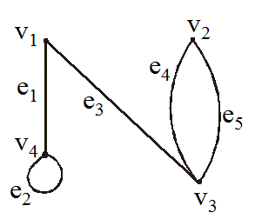
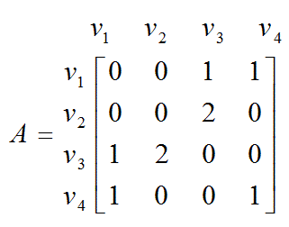
EXAMPLE
A graph with it’s adjacency matrix is shown.
Clearly graph has four vertices. It means that the corresponding square matrix will be order 4 x 4.

Slide 49
EXERCISE
Find a graph that have the following adjacency matrix.
Its order is 3 x 3, it means its corresponding graph has three vertices.
Let the three vertices of the graph be named v₁, v₂ and v₃

Slide 51
DIRECTED GRAPH
A directed graph or digraph, consists of two finite sets: a set V(G) of vertices and a set D(G) of directed edges,
where each edge is associated with an ordered pair of vertices called its end points.
If edge e is associated with the pair (v, w) of vertices, then e is said to be the directed edge from v to w and is represented by drawing an arrow from v to w.

Slide 52
EXAMPLE OF DIGRAPGH

Slide 53
ADJACENCY MATRIX OF A DIRECTED GRAPH
Let G be a graph with ordered vertices
v₁, v₂, …, v_{n}.
The adjacency matrix of G is the matrix A = [a_{ij}] over the set of non-negative integers such that
a_{ij} = the number of arrows from v_{i} to v_{j}
for all i, j = 1, 2, …, n.

Slide 54
EXAMPLE
A directed graph with its adjacency matrix is shown
Adjacency matrix

Slide 55
EXERCISE
Find directed graph that has the adjacency matrix
The order of matrix is 4 x 4, it means it has 4 vertices.

Slide 56
SOLUTION
The 4 × 4 adjacency matrix shows that the graph has 4 vertices say v₁, v₂, v₃ and v₄ labeled across the top and down the left side of the matrix.

Slide 57
A corresponding directed graph is
It means that a loop exists from v₁ and v₃ , two arrows go from v₁ to v₄ and two from v₃ and v₂ and one arrow go from v₁ to v_{3 ,} v₂ to v_{3 ,} v₃ to v_{4,} v₄ to v₂ and v_{3.}

Slide 58
INCIDENCE MATRIX OF A SIMPLE GRAPH
Let G be a graph with vertices v₁, v₂, …, v_{n} and edges e₁, e₂, …, e_{n}.
The incidence matrix of G is the matrix M = [m_{ij}] of size n × m defined by:

Slide 59
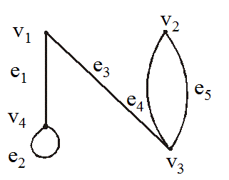
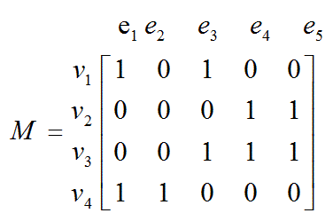
EXERCISE
A graph with its incidence matrix is shown.

Slide 60
REMARK
In the incidence matrix:
Parallel edges are represented by columns with identical entries (in this matrix e₄ & e₅ are parallel edges).
Loops are represented using a column with exactly one entry equal to 1, corresponding to the vertex that is incident with this loop and other zeros (here e₂ is only a loop).

